Slide 1

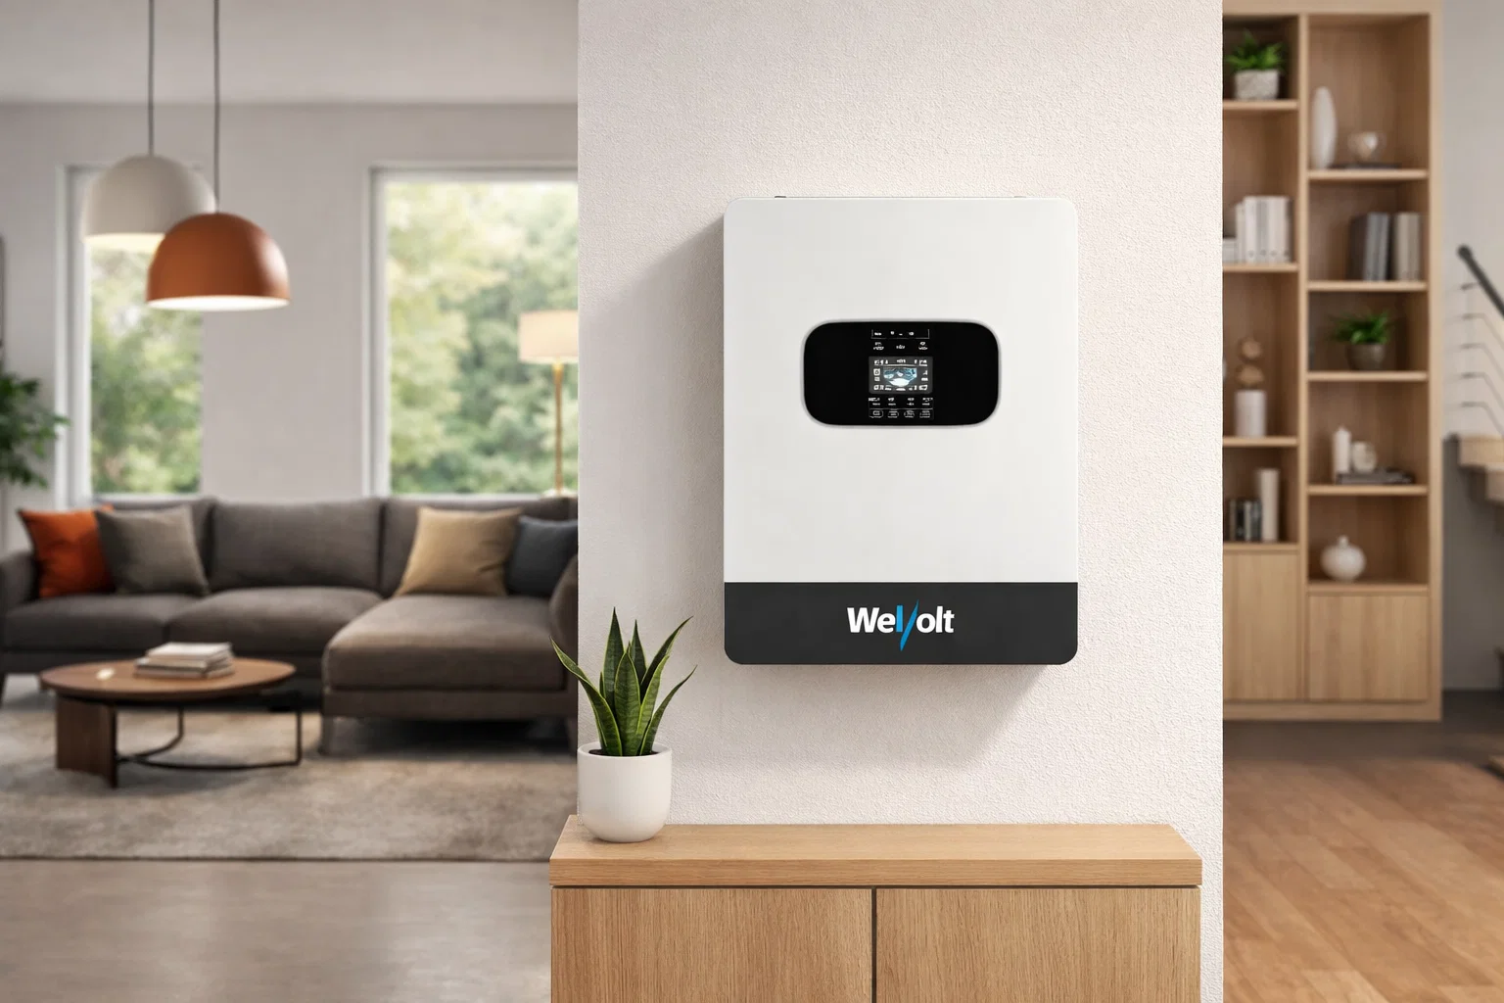
Inverter Compatibility List
This document applies to all WeVolt Inverters, including three-phase, standard single-phase and split phase inverters.
WeVolt off-grid inverters support Pylontech RS485 low-voltage V3.5 communication and are compatible with most Mainstream Batteries.
Note:
Please input inverter setup number to lithium mode for corresponding battery.
Please connect inverter to battery prior to inverter setup.
If your battery brand or version is not listed, please contact us to confirm compatibility.
Last Update:
2026/03/06
Customer Support:
Support@wevolt.global

Slide 2
Datasheet
Brand | Model | Communication
Seplos | Mason 230 / 280 / 314L / 560 / Satana / Pusung-R / DNA-105 / POLO series | RS485 / CAN, Pylontech RS485 low-voltage V3.5
Seplos DIY Kits | Mason DIY kits / V3 / V4 kits | RS485 / CAN, Pylontech RS485 low-voltage V3.5
JK Inverter BMS | JK PB series / JK V19 | RS485 / CAN, PYLON low-voltage RS485 V3.5
EEL Battery | V6 / V3 / V4 boxes with JK V19 or Seplos BMS | RS485 / CAN, depends on BMS
Yixiang | V2 DIY JK BMS battery case | RS485 / CAN, Pylontech RS485 low-voltage V3.5
JBD | 280L / 24280B DIY kits | RS485 / CAN, Pylontech RS485 low-voltage V3.5
Gobel Power | 48V DIY / server rack packs | RS485 / CAN, Pylontech V3.5
Docan Power | 48V DIY / PACE-BMS packs | RS485 / CAN, Pylon-485-V3.5
BasenGreen | Wall / floor mounted 48V packs | RS485 / CAN, Pylon-485-V3.5
Fogstar Energy | 5.12kWh server rack / 16.1kWh ECO / Drift 48V | RS485 / CAN, Pylontech protocol; V3.5 verification required
Pylontech | US2000 / US2000V2 / US3000 / US2000C / US3000C / US5000 / US5000-B / UP5000 / UF5000 / Phantom-S / Force-L1/L2 / Pelio-L / Fidus-L | RS485 / CAN
Growatt | HOPE low-voltage series | RS485 / CAN, Pylontech protocol selectable; V3.5 verification required
BSLBATT | B-LFP48 Powerwall / Rack / Li-PRO / PowerLine-5 | RS485 / CAN, PYLON RS485 LV-BPB V3.5
Qoltec | 4.8kWh / 5.12kWh LiFePO4 ESS | RS485 / CAN, PYLON RS485 LV V3.5
Hollandia Power | Advanced Low Voltage 5kWh | RS485 / CAN, Pylontech RS485 V3.5
Rosen | 7.2kWh WD / 9.6kWh EJ | RS485 / CAN, Pylon low-voltage V3.5
Marvel Battery | Rack / wall LiFePO4 series | RS485 / CAN, Pylontech RS485 V3.5
Lightwave Global | LW-LiFe 5kW / 17.5kW | RS485 / CAN, PYLON RS485 LV V3.5

Slide 3
Datasheet
Brand | Model | Communication
Constance Energy / CST | CST-LR-51.2-280 | RS485 / CAN, PYLON RS485 LV V3.5
Dyness | A48100 / BX48100 / BX51100 / B3 / DL5.0 / DL5.0C / Powerbox Pro | RS485 / CAN, protocol version verification required
PowMr | POW-LIO48 / POW-LIO51 series | RS485 / CAN, Pylontech RS485 V3.5
Eco-Worthy / PowerMega | PowerMega 314 V2 48V 314Ah | RS485 / CAN, PYLON RS485 LV V3.5
Power Queen | 51.2V 100Ah server rack | RS485 / CAN, PYLON RS485 LV V3.5
Ingotta / Ruilida OEM | RSPB series | RS485 / CAN, PYLON RS485 LV V3.5
SJY / OEM | 51.2V 300Ah floor-standing pack | RS485 / CAN, PYLON RS485 LV V3.5

